Slide 1
[Organization Name]

Slide 2
DoNation Overview
DoNation is a national workplace initiative to encourage workplace employees and community members to sign up as organ, eye, and tissue donors
Sponsored by the Health Resources and Services Administration (HRSA) of the U.S. Department of Health and Human Services
Part of a longstanding nationwide effort that has added more than 630,000 registrations to the organ donor registry since 2011
Partners with thousands of workplaces and organ procurement organizations nationwide
Offers recognition from HRSA for completing campaign activities and registering new donors

Slide 3
DoNation Goals
Increase awareness about the importance of organ donation and transplantation
Encourage more people to sign up as organ, eye, and tissue donors
Create a donation-friendly workplace culture that radiates out to our culture at large

Slide 4
Why Is DoNation Important?
Over 100,000 people in the U.S. are in need of an organ transplant
41,354 transplants performed in 2021
17 people die each day because no organ is available
Every 10 minutes another person is added to the national transplant waiting list
Approximately 90% of U.S. adults support organ donation but only 60% are registered as donors

Slide 5
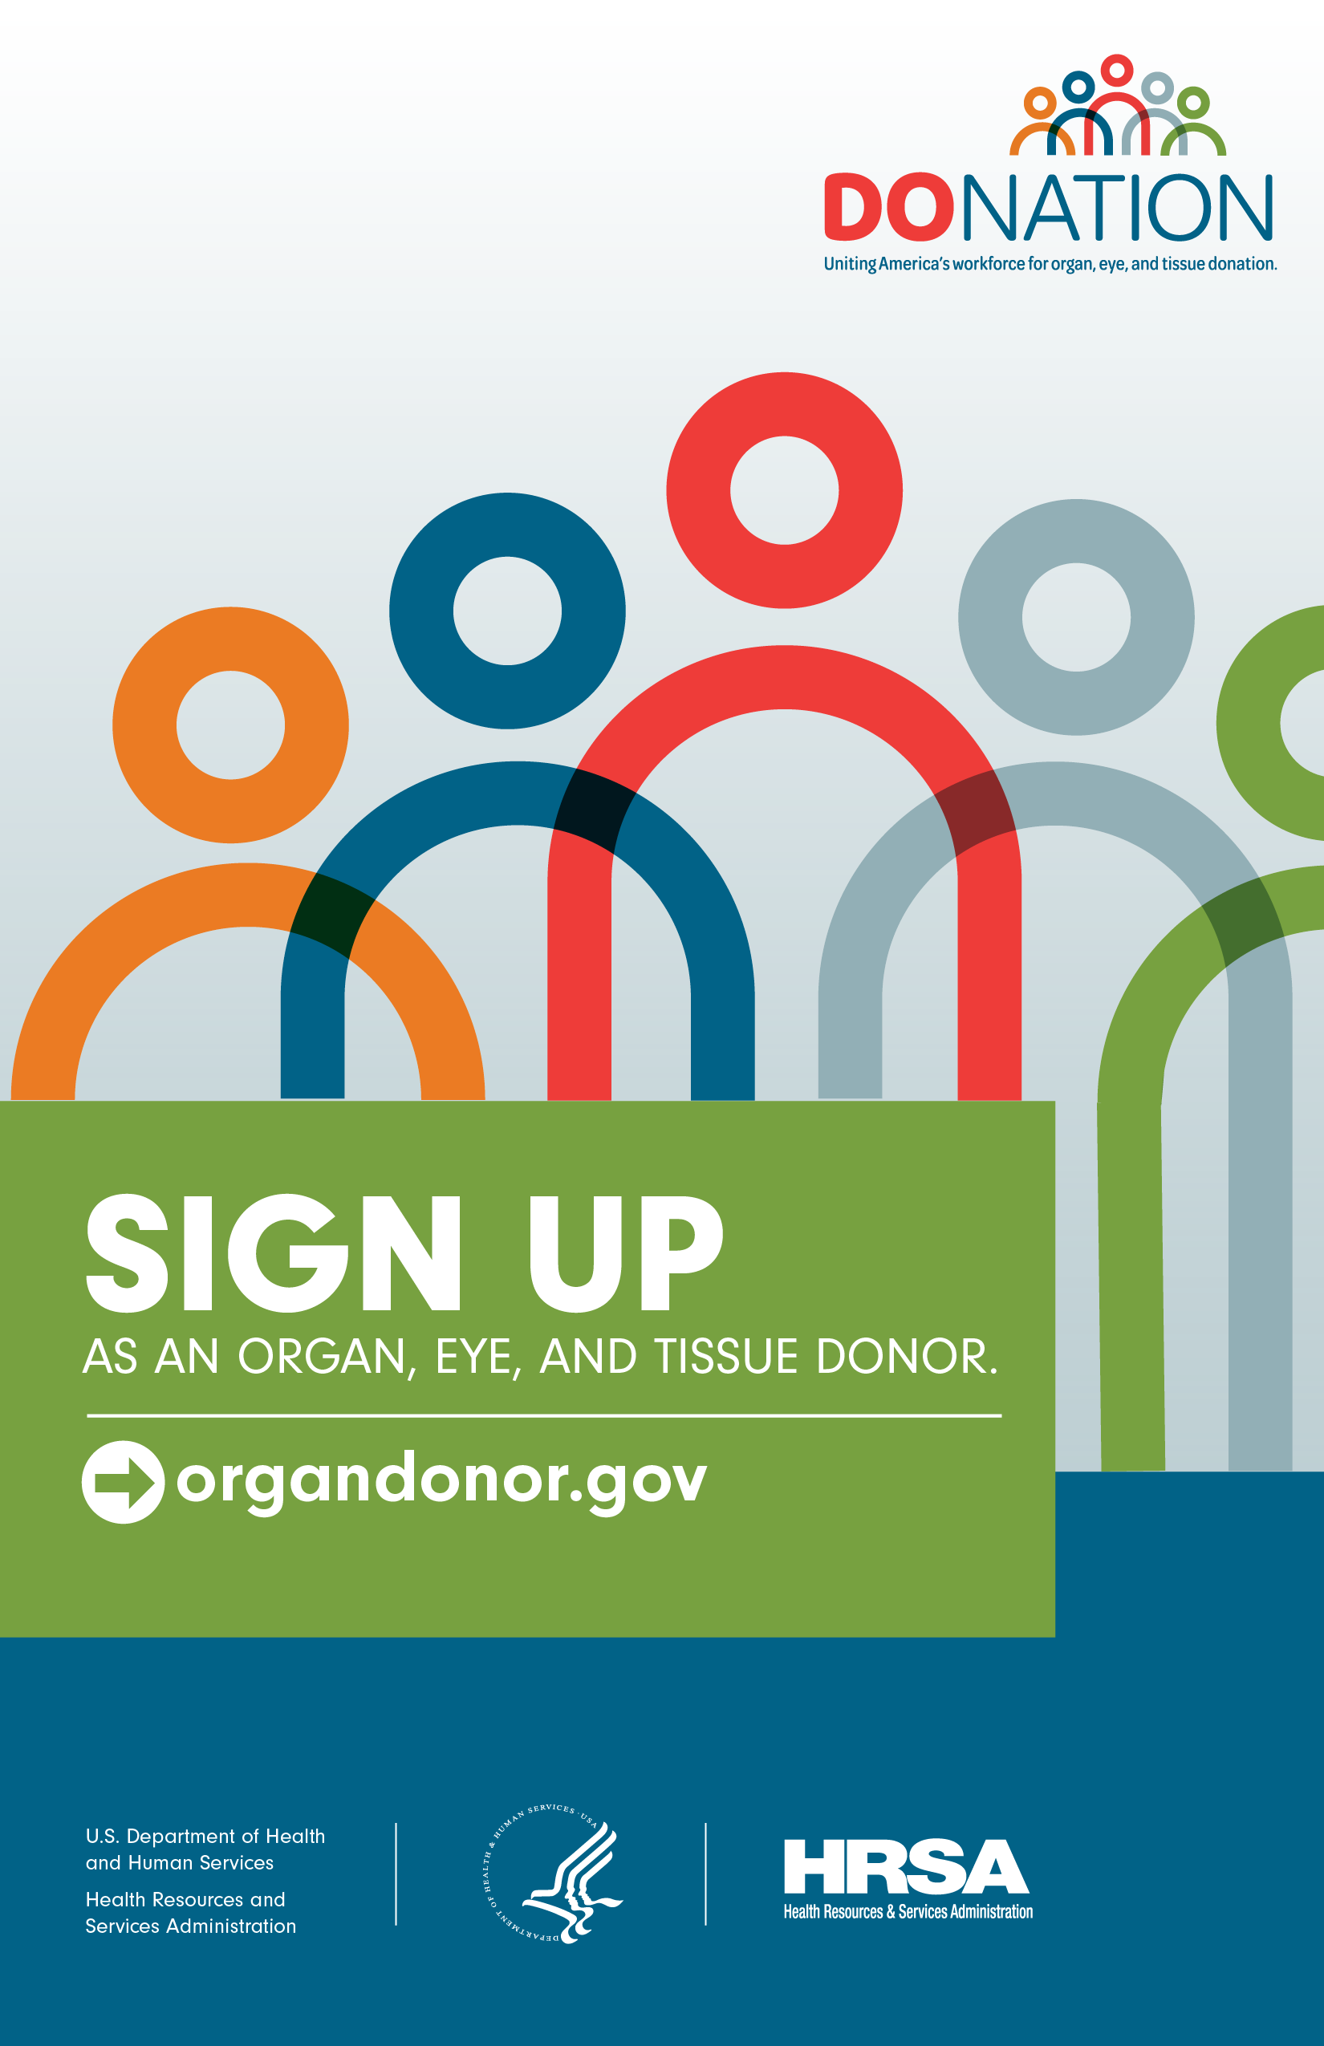
DoNation Materials and Resources
Campaign Scorecard
Includes a variety of activities to implement
Provides a framework for planning and
goal-setting
Informational and best-practice webinars
Social media graphics and messaging
Email, newsletter, and PSA templates
Web banners and badges
Printable posters

Slide 6
DoNation Recognition
Workplaces earn bronze, silver, gold, or platinum recognition from HRSA for completing activities and generating new donor registrations
HRSA provides recognition certificates and
materials (web badges, screensavers,
social media graphics) to celebrate campaign accomplishments
Platinum Participant

Slide 7

Organ Donation: Fast Facts
No one is too old or too young to be an organ donor
Many religions support organ donation
Doctors work just as hard to save the
lives of registered donors
Organ donation
Does not interfere with open casket funerals
Does not cost the donor family anything
Can give solace to a family experiencing grief and pain
Saves thousands of lives and improves countless more!
Signing up as a
donor is easy!
Register at organdonor.gov/sign-up

Slide 8
Organs & Tissues That Can Be Donated
Heart
Lungs (x2)
Liver
Kidneys (x2)
Pancreas
Intestines
Corneas
Skin
Bones
Tendons
Heart valves
Femoral and saphenous veins
Faces, hands, and arms
One organ donor can
save up to 8 lives, and
improve up to 75 more
with eye and tissue
donation.

Slide 9

Matching Donor Organs and Recipients
National database matches patients with donors
Organs are never matched based on race,
gender, income, social status
Factors considered in matching donors
and recipients include
Blood type Tissue type
Body size Time on waitlist
Severity of illness
Distance from donor

Slide 10
How Can I Participate in DoNation?
Participate in outreach activities and share them widely
Talk about organ donation with friends and family
Spread the organ donation message via social media
“Like” organdonor.gov and donaciondeorganos.gov
on Facebook
Share links to your state registry

Slide 11
Visit www.organdonor.gov or www.donaciondeorganos.gov to learn more about donation and transplantation!
LEARN
MORE

